Slide 1
Reductions in photosynthetic nitrogen demand due to elevated CO₂ increases simulated future ecosystem carbon storage
Nick Smith (Texas Tech University; nick.smith@ttu.edu)
Qing Zhu, Bill Riley, and Trevor Keenan (Berkeley Lab)

Slide 2
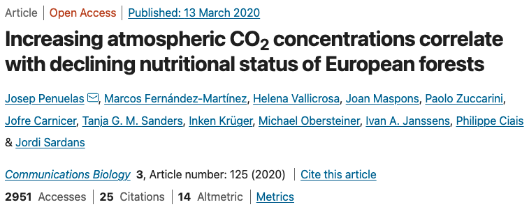
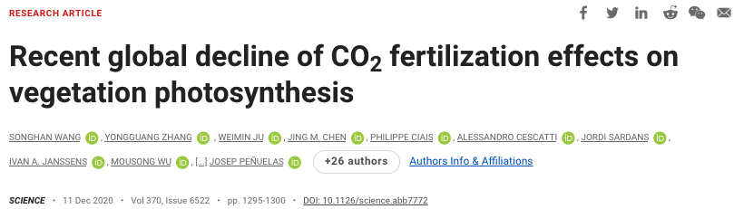
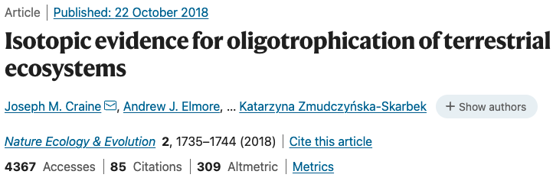
Leaf N is decreasing with elevated CO₂
nick.smith@ttu.edu; @nick_greg_smith
Average: 0.2 to 0.25% year⁻¹

Slide 3
Leaf N demand decreases with increasing CO₂
nick.smith@ttu.edu; @nick_greg_smith
Dong et al. (2022)

Slide 4
Leaf N demand decreases with increasing CO₂
nick.smith@ttu.edu; @nick_greg_smith
Smith and Keenan (2020)

Slide 5
Eco-evolutionary optimality theory can predict CO₂-induced reductions in leaf N
nick.smith@ttu.edu; @nick_greg_smith
Model: Dong et al. (2022)
Data: Zheng et al. (2019)

Slide 6
Eco-evolutionary optimality theory can predict CO₂-induced reductions in leaf N
nick.smith@ttu.edu; @nick_greg_smith
Smith and Keenan (2020)

Slide 7
What do reductions in leaf N demand mean for ecosystem C-N dynamics under future, elevated CO₂?
nick.smith@ttu.edu; @nick_greg_smith

Slide 8

ELM simulations
nick.smith@ttu.edu; @nick_greg_smith
All simulations included optimal V_{cmax} and J_{max} (Smith and Keenan, 2020)
All simulations included dynamic carbon and nitrogen allocation (Zhu et al., 2019)
2 simulations with different N dynamics
Leaf N is determined by N availability in soil
Leaf N is determined by N demand for photosynthetic biochemistry

Slide 9
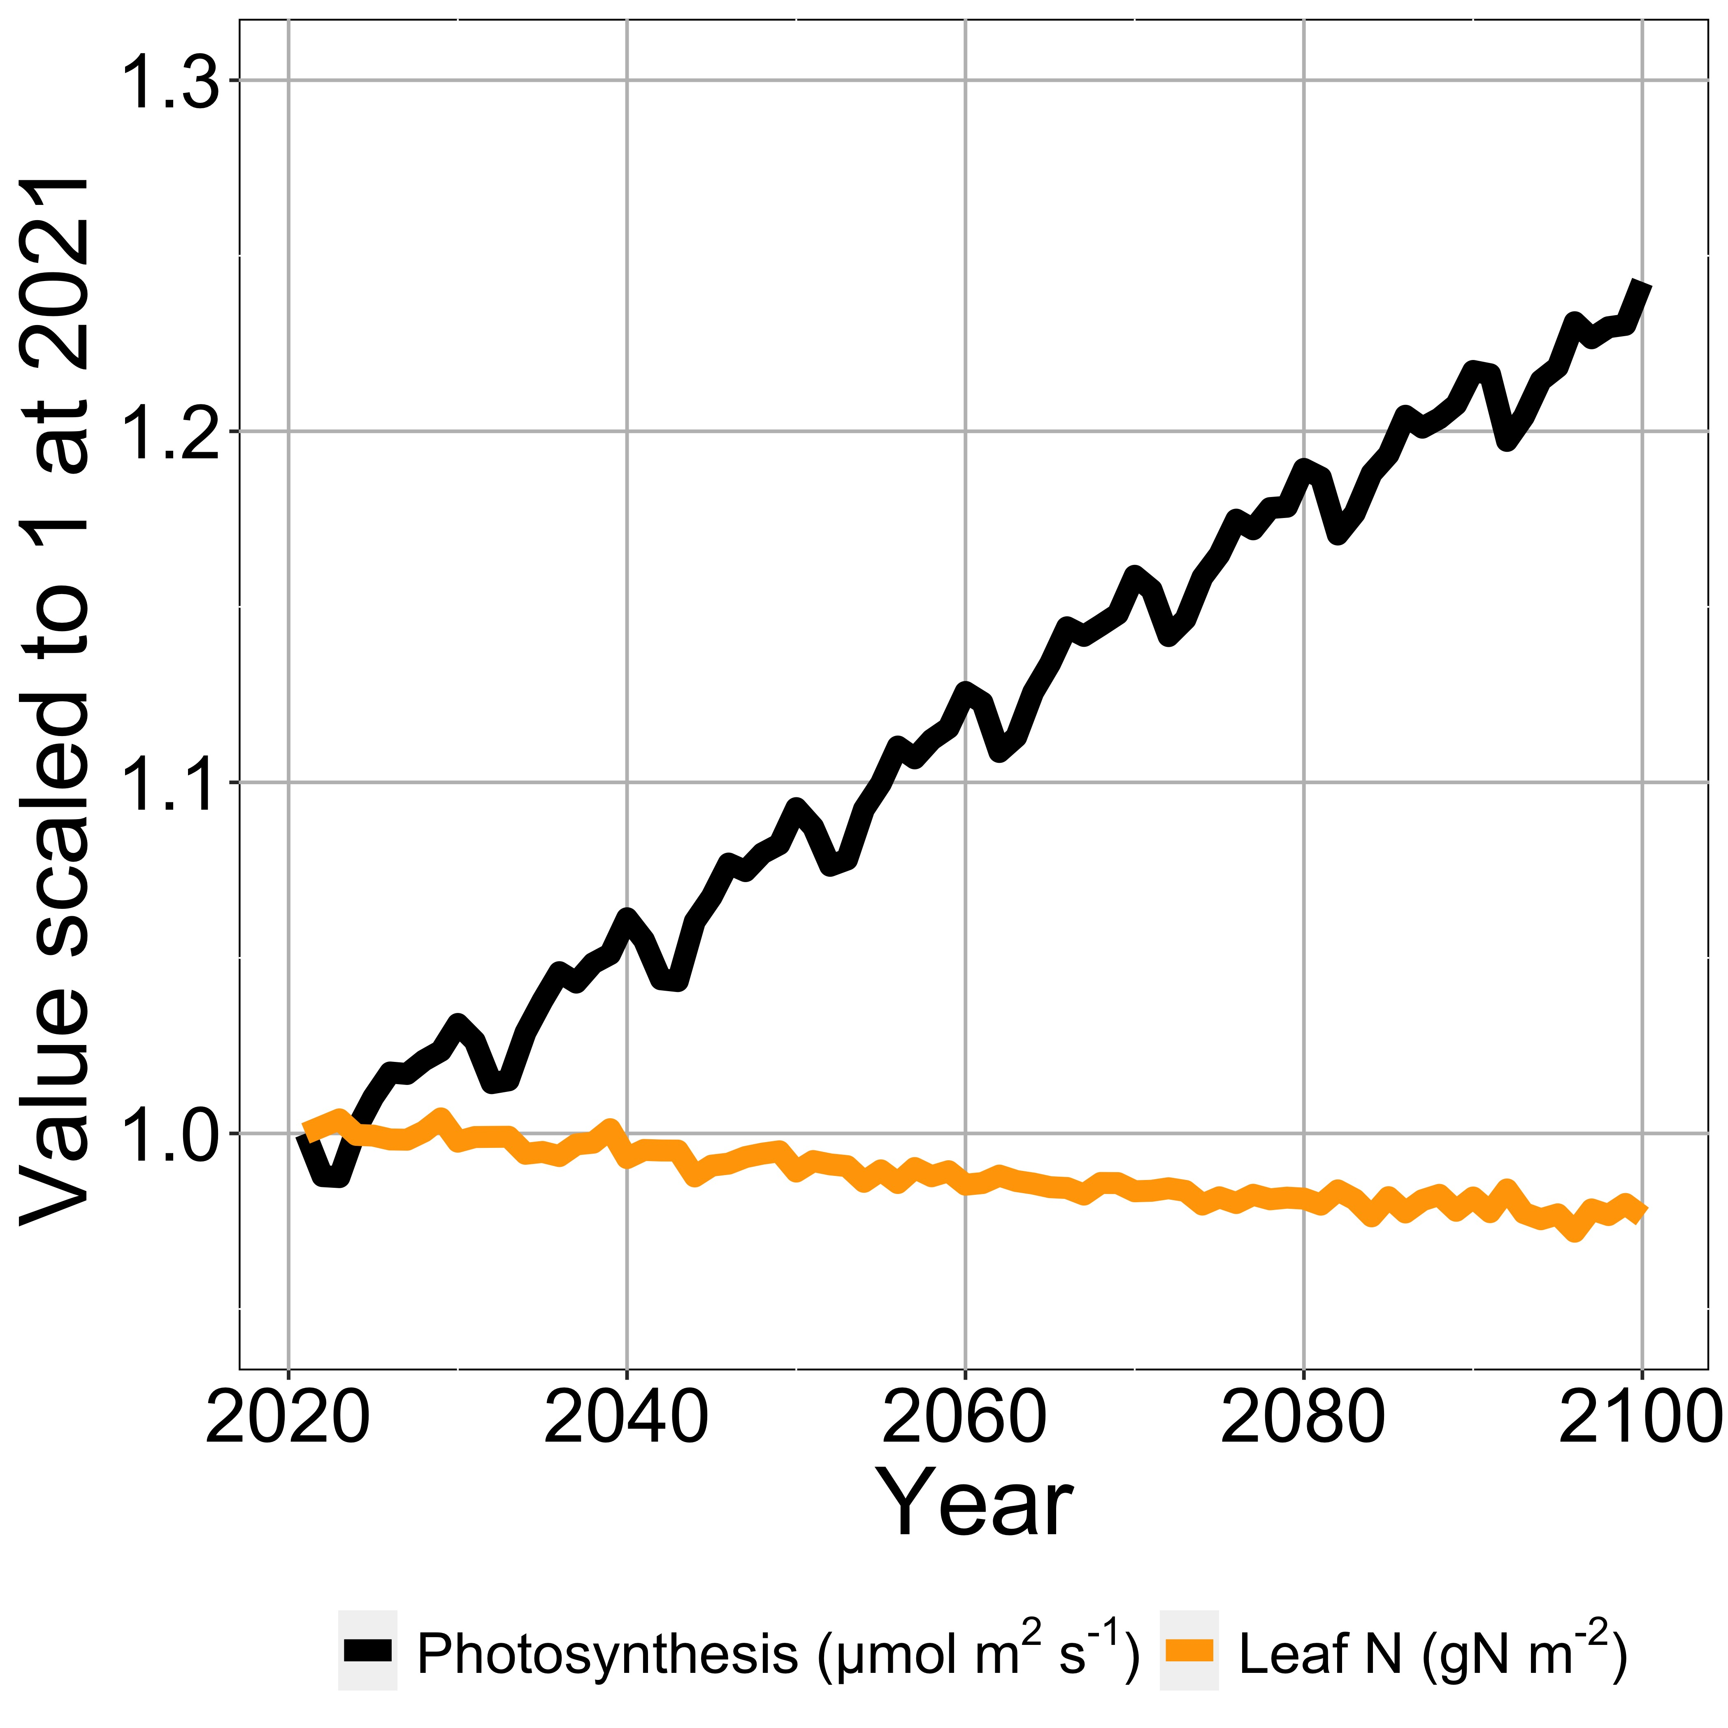
Photosynthesis increases with elevated CO₂ at lower leaf N
nick.smith@ttu.edu; @nick_greg_smith

Slide 10
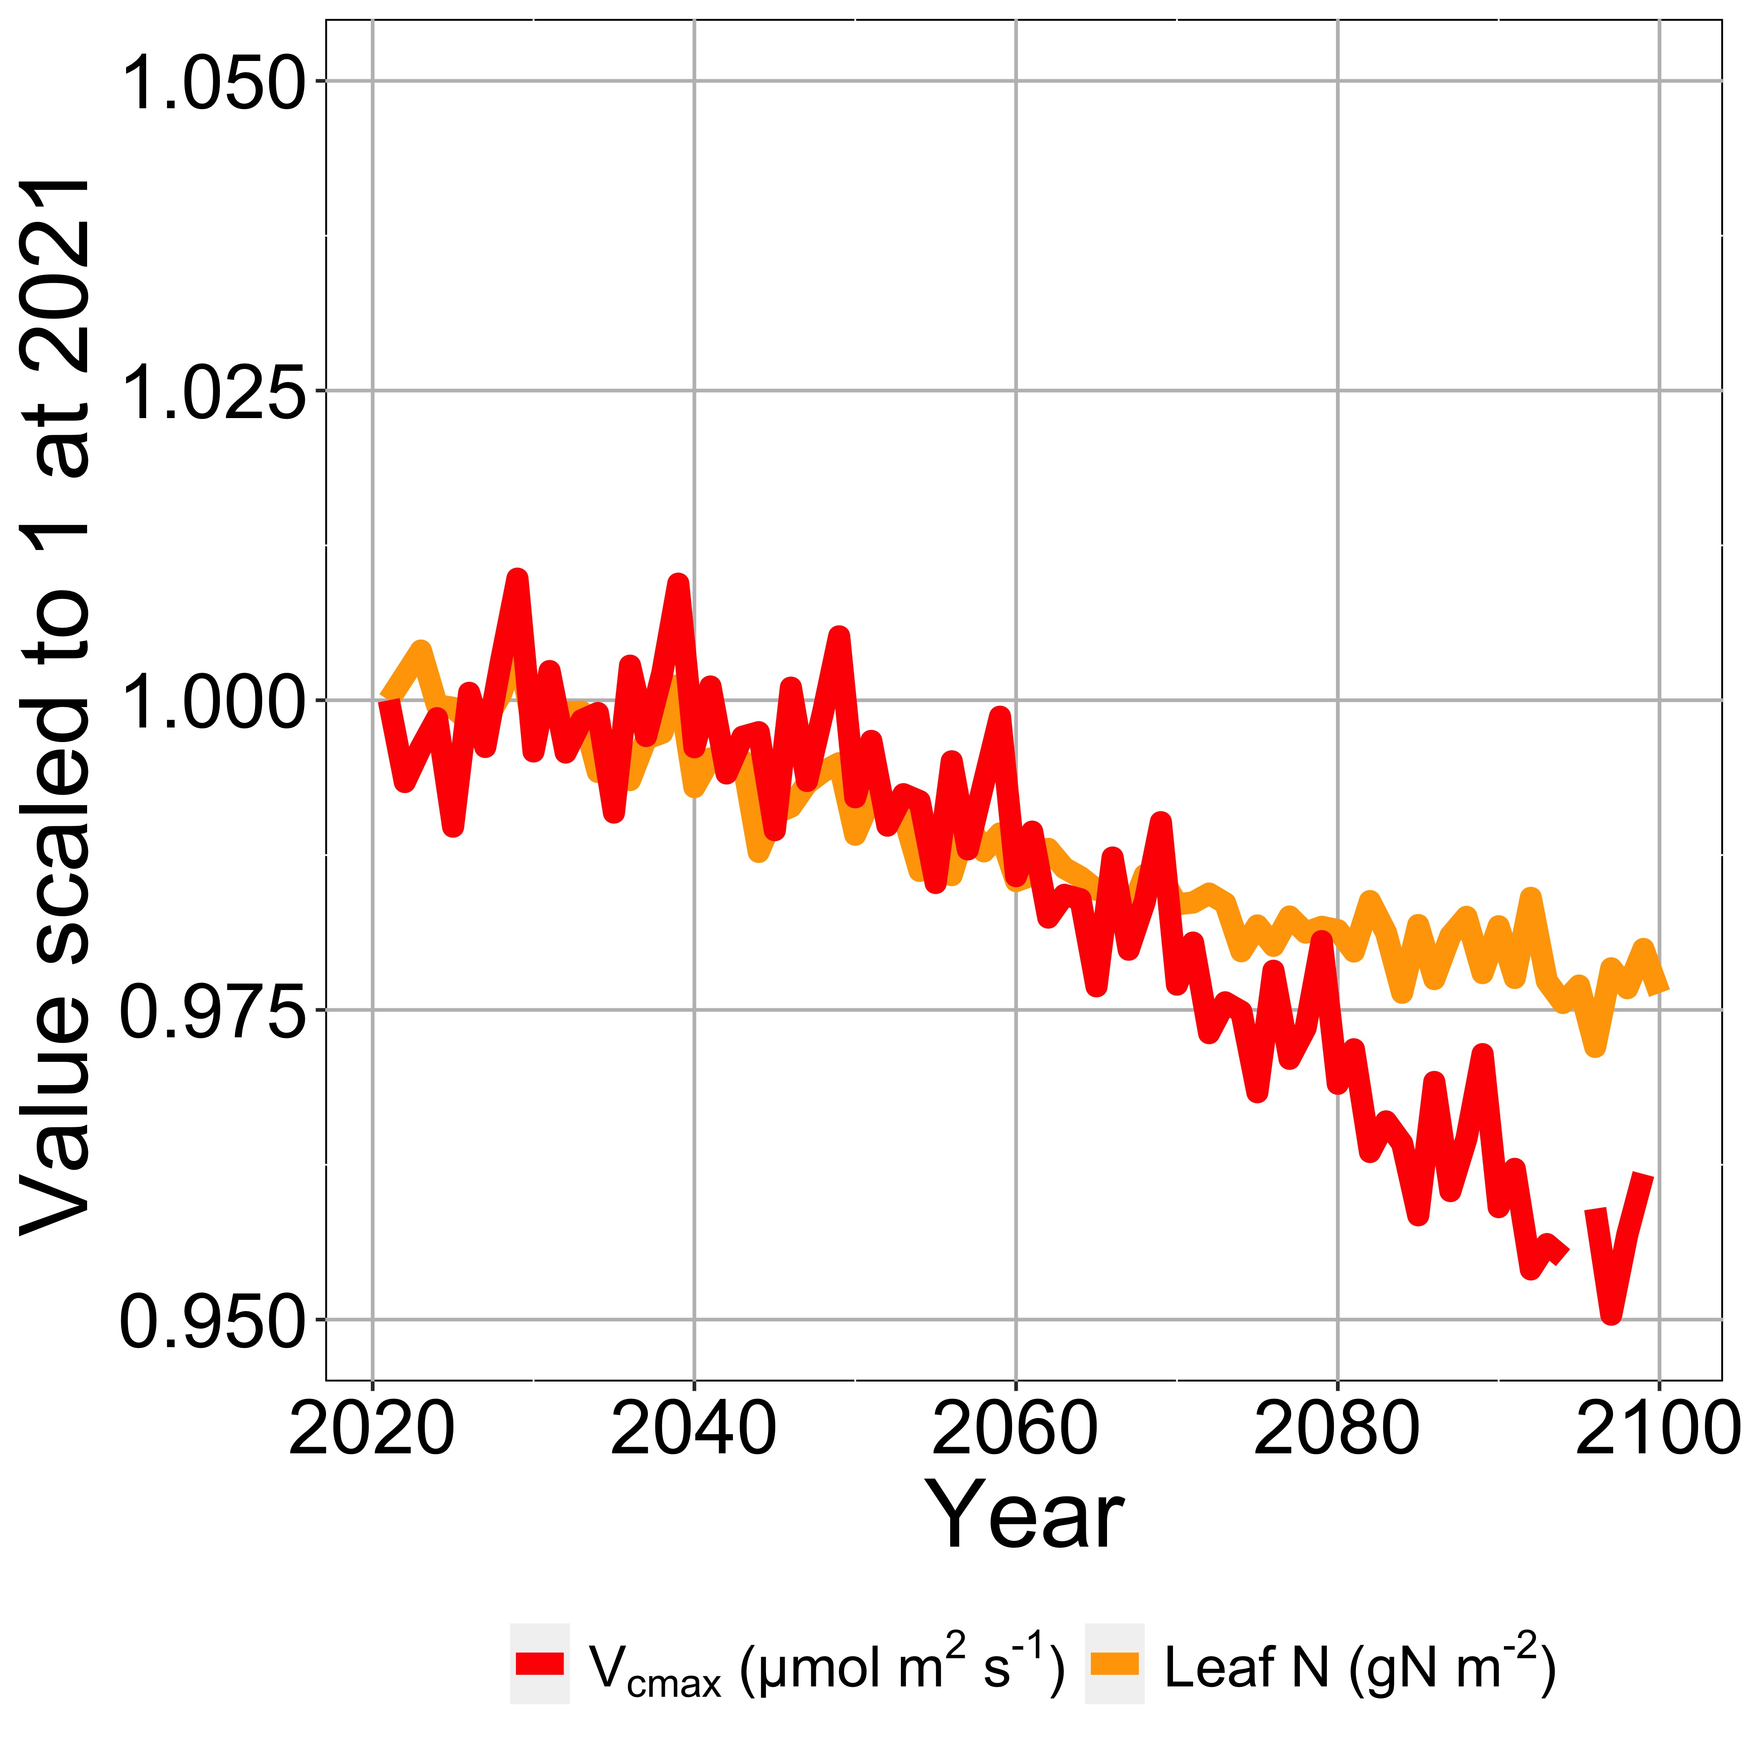
Leaf N reduction is due to a reduction in photosynthetic capacity
nick.smith@ttu.edu; @nick_greg_smith

Slide 11
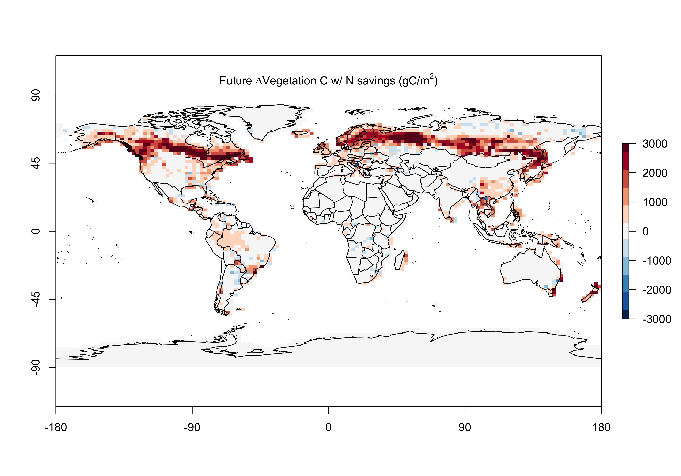
Leaf N savings increases plant growth
nick.smith@ttu.edu; @nick_greg_smith

Slide 12
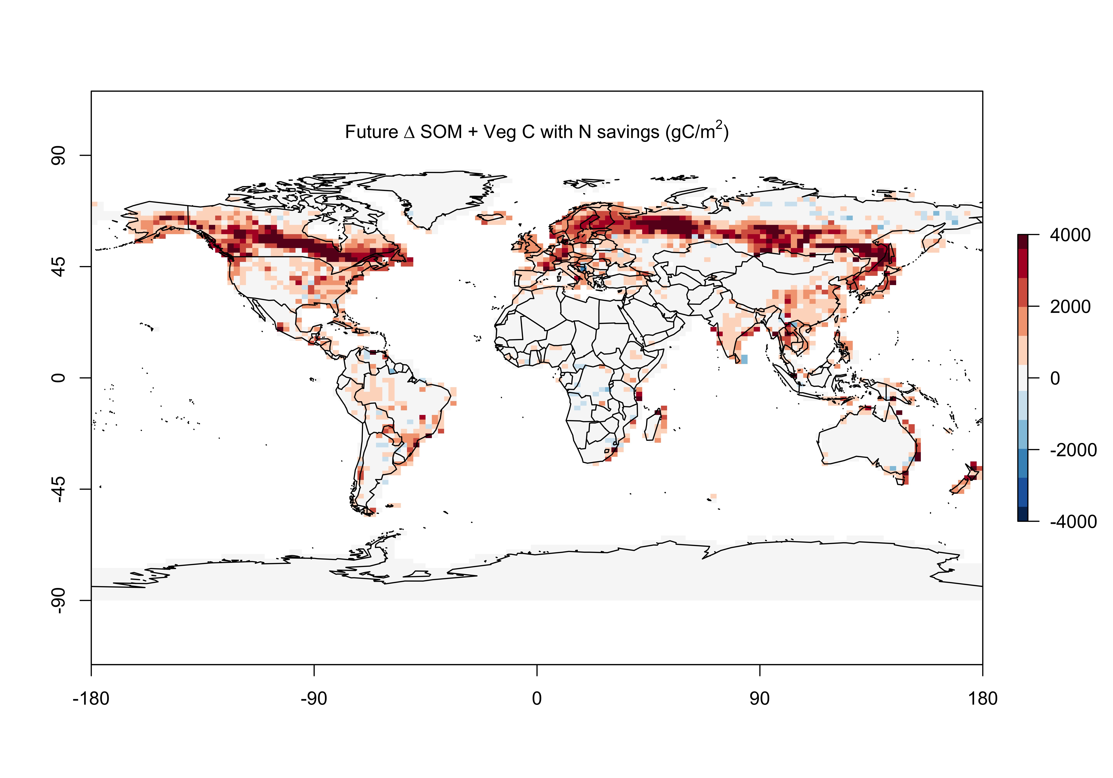
Result 3: Leaf N savings increases long-term ecosystem carbon stocks
nick.smith@ttu.edu; @nick_greg_smith

Slide 13
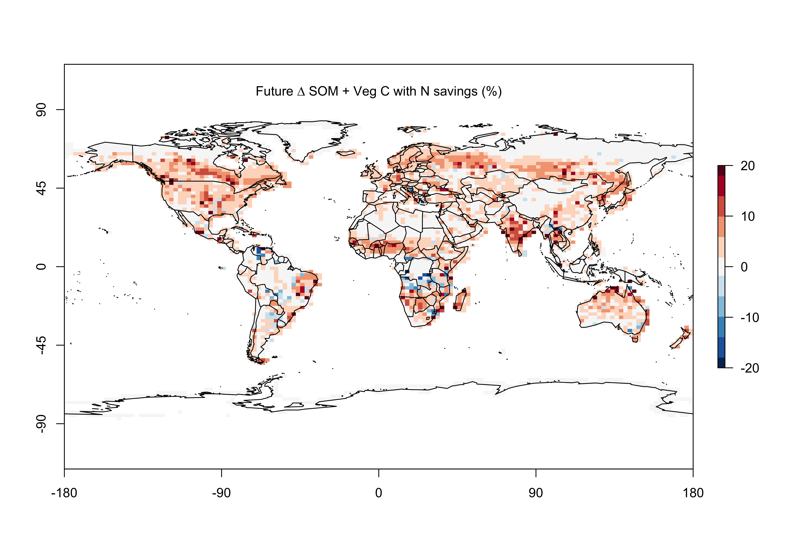
Result 3: Leaf N savings increases long-term ecosystem carbon stocks
nick.smith@ttu.edu; @nick_greg_smith

Slide 14
What does this all mean?
nick.smith@ttu.edu; @nick_greg_smith

Slide 15
Future progressive nutrient limitation may be overestimated
nick.smith@ttu.edu; @nick_greg_smith
“No limitation” simulation
“Nutrient limitation” simulations
Weider et al. (2015)

Slide 16
Conclusions
nick.smith@ttu.edu; @nick_greg_smith
Photosynthetic N demand is reduced under future elevated CO₂ and temperature
Least cost optimality theory can predict this
The theory can (and should) be incorporated into ESMs
No added parameters
Progressive nitrogen limitation may not be as strong as current models predict

Slide 17



nick.smith@ttu.edu; @nick_greg_smith
Presentation available at:
www.github.com/SmithEcophysLab/seminar/egu_2022
Thanks!

Slide 18
CO₂
Leaf N %
Photosynthesis
Plant growth
Soil N
Positive effect
Negative effect
Notes:
Traditional paradigm of nitrogen limitation of photosynthesis

Slide 19
CO₂
Leaf N demand
Leaf N %
Photosynthesis
Plant growth
Soil N
Positive effect
Negative effect
Notes:
Alternative paradigm for how CO2 impacts leaf N

Slide 20
CO₂
Leaf N demand
Leaf N %
Photosynthesis
Soil N uptake
Plant growth
Soil N
Positive effect
Negative effect
Notes:
Way by which CO2 could actually increase soil N!

Slide 21
CO₂
Leaf N demand
Leaf N %
Photosynthesis
Soil N uptake
Plant growth
Soil N
Positive effect
Negative effect
Notes:
Proposed path

